Slide 1
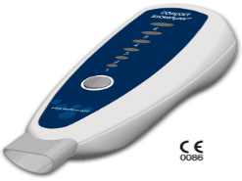

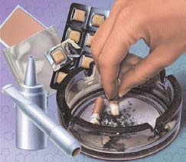
Pilot study of an electronic decision support system for SMI smokers
Is feedback from a carbon monoxide monitor necessary?
Mary Brunette, Geisel School of Medicine at Dartmouth
Timothy Devitt, Thresholds Inc
October 2014
National Institute on Disability and Rehabilitation Research
Bristol Meyer Squibb Foundation

Slide 2

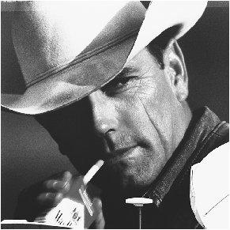
Smoking and mental illness
(Lasser et al, 2000)
2007 Prevalence:
18% without MI
30-60% with MI
(McClave, 2009)
Notes:
This chart shows rates of lifetime smoking and smoking cessation from the national Comorbidity Study. 4411 respondents interviewed in 1991-1992. The data show higher rates of smoking among people with schizophrenia and lower rates of quitting compared to people in the general pop
People with mental illness are nicotine dependent at a rate 2-3 times higher than other smokers
Smoke more cigarettes (de Leon 02)
Have higher dependence (Etter 04)
Inhale more nicotine per puff (Tidey 05, Williams 05)
Smoking is associated with a variety of health risks and the maintainance of high rates of smoking in people with schiz if probably one reason for the early mortality.

Slide 3

Heart disease and cancers are primary causes of death in persons with MI
30 year early mortality
Data from Oklahoma 1996-2000; Colton et al, 2006

Slide 4
What are some reasons clinicians do not address helping people quit smoking as part of treatment?

Slide 5
But people with SMI aren’t interested in treatment
Many people with SMI want to quit (Baker, 2007)
Idiosyncratic events motivate cessation (Davis, 2010)
Around 40% or more try each year, average 1-2 ineffective quit attempts past year (Ferron, In press; Lucksted, 2004)
People with SMI not interested in tx (Morris, 2010)
Notes:
Around 40% or more try each year, average 1-2 ineffective quit attempts past year (Ferron, et al., 2011; Lucksted, 2004) - when you ask people how they want to quit – they say cold turkey. They don’t want tx. Long study nh – 11 yrs – 40% tried to quit each year. 80% had tried to quit once. When they did – their length of abst was less than 6 wks. Most of these people are not using quit smoking treatment. They are going Cold Turkey – stop abruptly.

Slide 6
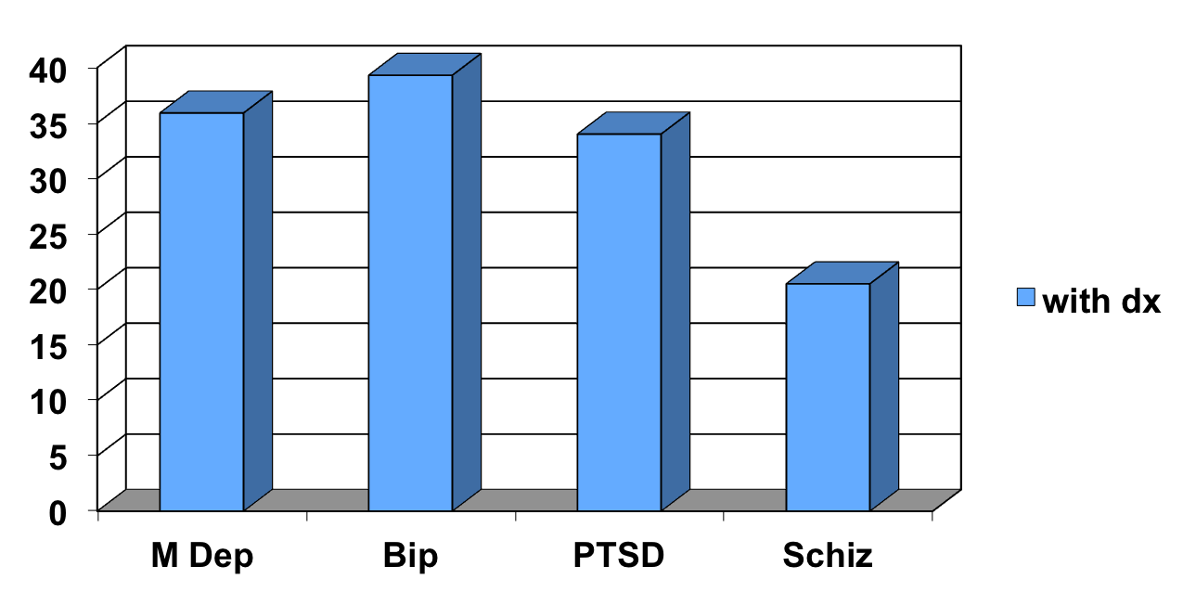
Cessation treatments improve cessation outcomes in SMI
6-12 wks group behav tx +/- NRT or bup
Notes:
One week abstinence after naturalistic treatment in VA program (Gershon-Grand 2007)

Slide 7
HOW DO WE ENGAGE CLIENTS with severe mental illness IN QUIT SMOKING TREATMENT??
WHAT IS NEEDED?

Slide 8
MOTIVATIONAL INTERVIEWING
4 studies show efficacy of MI in people with schizophrenia and other SMI compared to education or not intervention
  (Steinberg 2004; Steinberg 2012; Cather 2010; Williams 2010)
Motivational interventions are not delivered in typical community mental health treatment settings
Can websites or other electronic tools improve the reach of smoking cessation engagement interventions?
Currently accessible websites were not usable by SMI smokers (Brunette et al, 2011)

Slide 9
DARTMOUTH SMOKING CESSATION MOTIVATIONAL DECISION SUPPORT SYSTEM
Targets:
  Motivate to quit
  Motivate to choose evidence-based treatment
Provide information on treatment options and referral to treatment
Welcoming to all racial and ethnic groups
Based on Theory of Planned Behavior, Motivational Interviewing, and Decision support

Slide 10
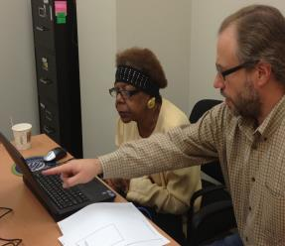
Dartmouth web-based motivational decision support system
Based on usability testing with 85 SMI smokers (Ferron et al., 2011) and research of others (Rotondi, 2007)
    Computer mouse tutorial
    Simple, linear design – only 2 layers deep
    Large buttons, font
    Simplified language - 5th grade level
    Text to Audio (for slow or poor readers)
Content is based on theory of planned behavior: address attitudes, social norms and perceived
  behavioral control
    Video hosts with SMI
    Quit using treatment testimonials
    Use of perceived loss and perceived gain framing
    Guided by focus groups and feedback from
    user population

Slide 11
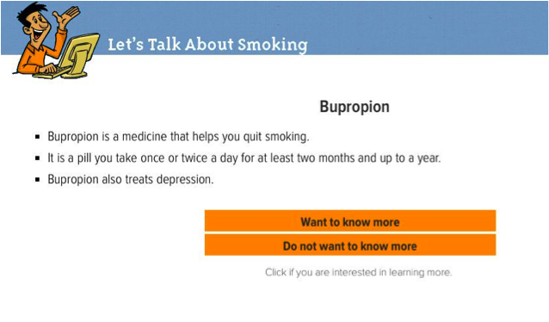
Figure 1. Screenshot of the Motivational Decision Support System
Smoking2.dartmouth.edu

Slide 12
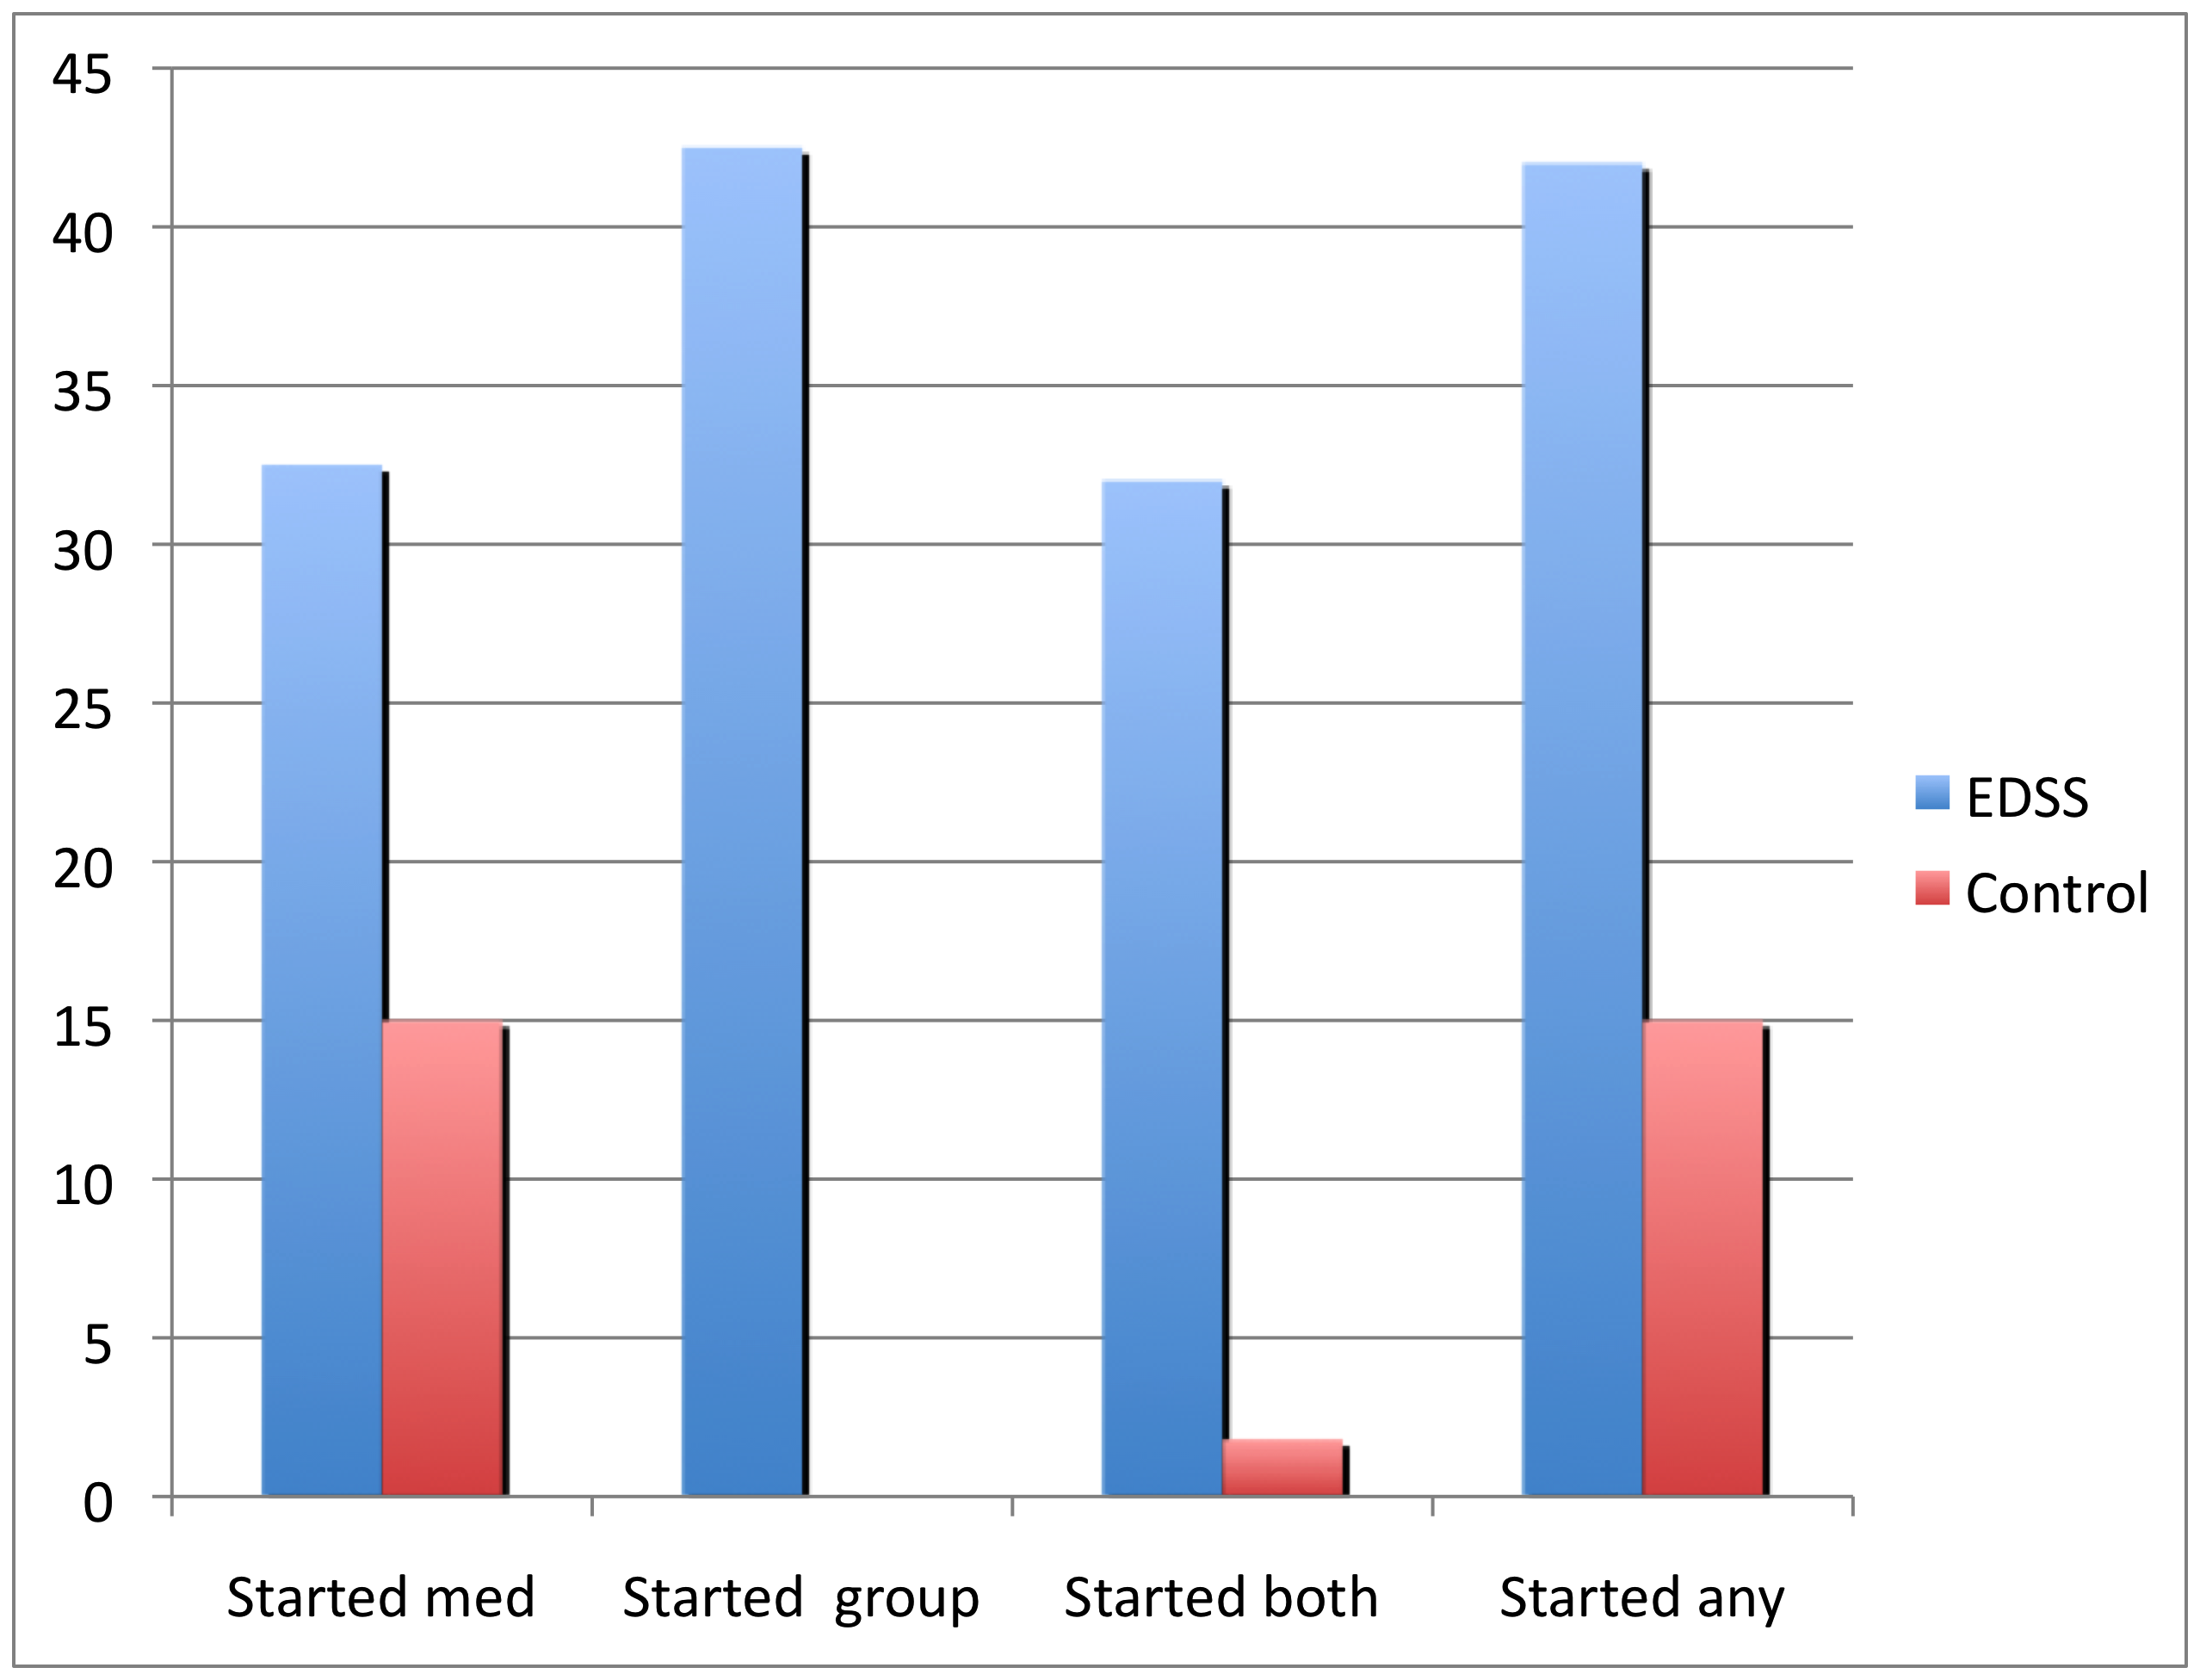
QUASI-EXPERIMENTAL PILOT:
Proportion of 60 participants who started treatment
(Brunette et al 2011, Psych Serv)

Slide 13
What is motivational about the EDSS?
Components of motivational interventions for smoking cessation in SMI
  Information about consequences of smoking
  Assessment and personalized feedback
    Money spent on cigarettes
    Personal pros and cons of smoking
    CO monitor reading & interpretation

Slide 14

CO monitor
CO is one of the toxins in cigarette smoke
Monitor provides reading that correlates
with amount user smoked recently
Provides personalized feedback →
hypothesized to increase perception of
personal health risk
All of the motivational interventions tested in SMI used CO monitor
Results from studies of CO monitor ingeneral population are mixed, but they used distal outcome of abstinence
Monitor not available to people who would use EDSS from home or library
CMHCs and other treatment settings may not be willing or able to provide CO monitor
Monitors are expensive

Slide 15
Other ways to personalize health risks?
Health checklist with feedback
  Shown to reduce problem drinking (Riper 2009)
  Component of MI for SMI (Steinberg et al 2004)
  Easy to incorporate and use
  Free

Slide 16
Study design: Randomized, controlled test with 6 month follow-up
Aims: RCT to assess whether EDSS with CO monitor and health checklist feedback leads to higher rates of smoking cessation tx initiation that EDSS with health checklist alone
Consent Baseline Interview
EDSS CO monitor & checklist
Interview
EDSS health checklist
Interview
Consent/Baseline
Computer Visit
2 mo f/u
6 mo f/u
Interview
Interview
Notes:
Baseline visit
Consent
Assessment
Randomize to
EDSS CO monitor
EDSS without monitor
EDSS visit within 2 weeks
Assessment visits for outcome evaluation 2 and 6 months after using EDSS

Slide 17
assessments
Treatment use & quit behaviors; self report verified by chart/clinician
  Smoking amount and abstinence: Timeline Follow-back at 2 & 6 mo)
  Beliefs about treatment, Intention to use treatment, intention to quit : Theory of Planned Behavior Questionnaire
  Knowledge & Attitudes: Attitudes towards smoking scale; Disengagement beliefs scale
  Symptoms (baseline)
    Modified Colorado Symptom Index
  Cognition (baseline)
    BACS (Brief Assessment of Cognition)
    WRAT (Wide Range Achievement Test)
  Perceived social support (Multidimensional Scale of Perceived Social Support) with screener

Slide 18
outcomes

Slide 19
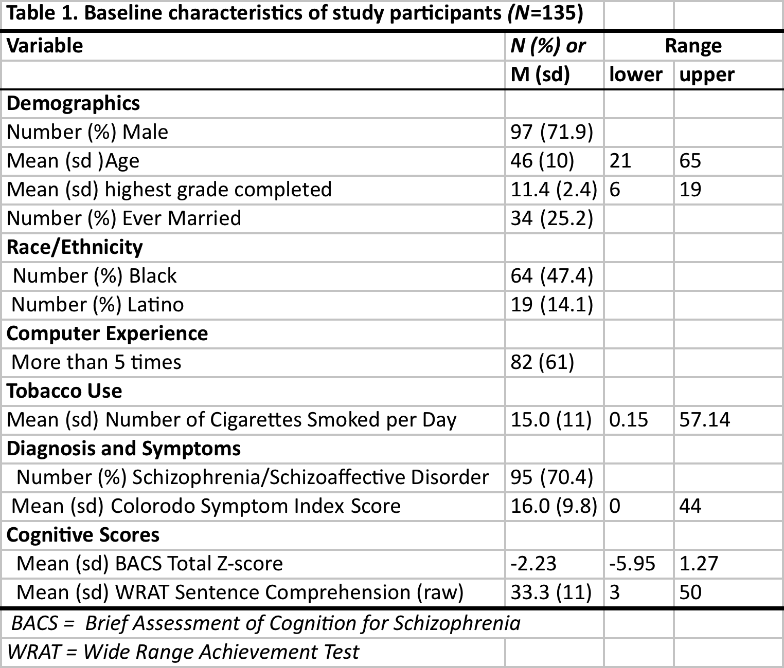
STUDY SAMPLE (N=135)
(NO DIFFERENCES BETWEEN GROUPS)
Notes:
No differences on demos, smoking vars, or cognitive vars at baseline

Slide 20
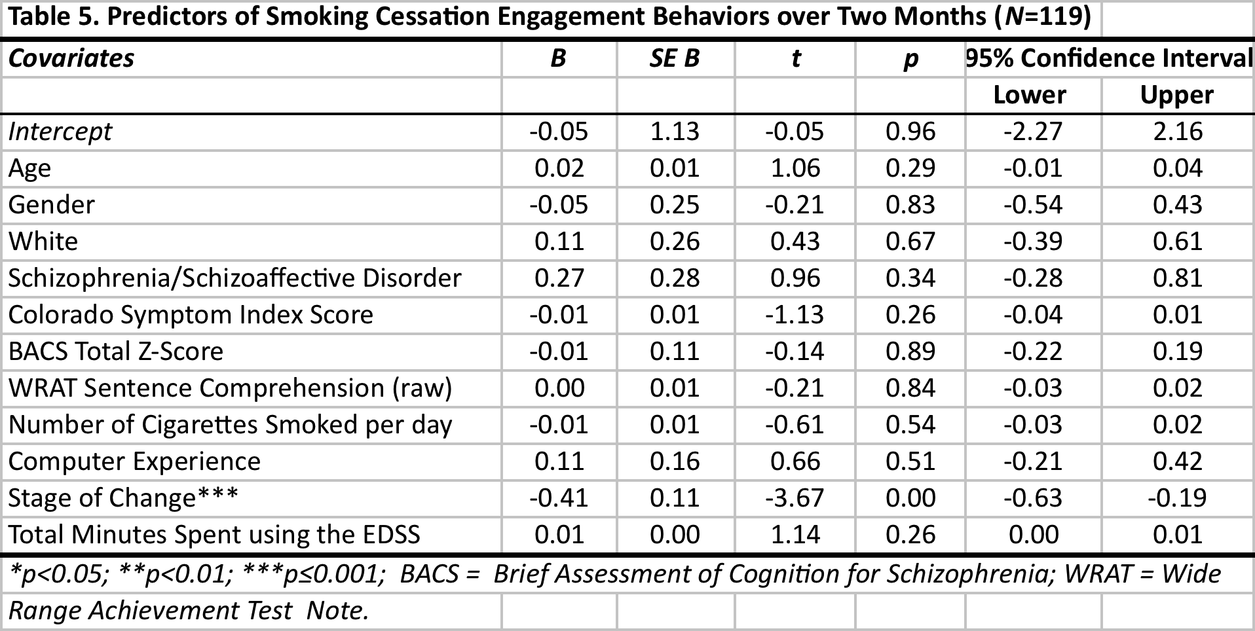

Slide 21
RCT of 2 versions (with and without feedback from CO monitor; N=124)
Regression analysis, controlling for stage of change showed no between group difference in treatment initiation at 2 month follow-up
Overall, 32.5% initiated cessation treatment
Concluded that feedback from
CO monitor not necessary

Slide 22
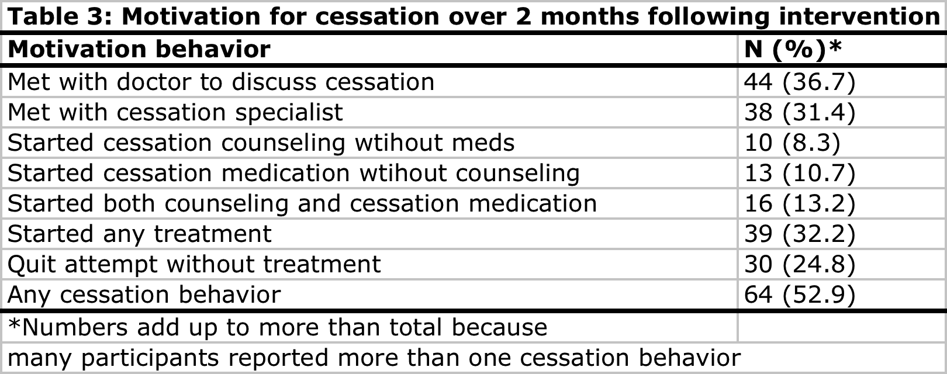
ENGAGEMENT OUTCOMES IN 124 SMOKERS WITH SMI (BRUNETTE ET AL, 2013)

Slide 23
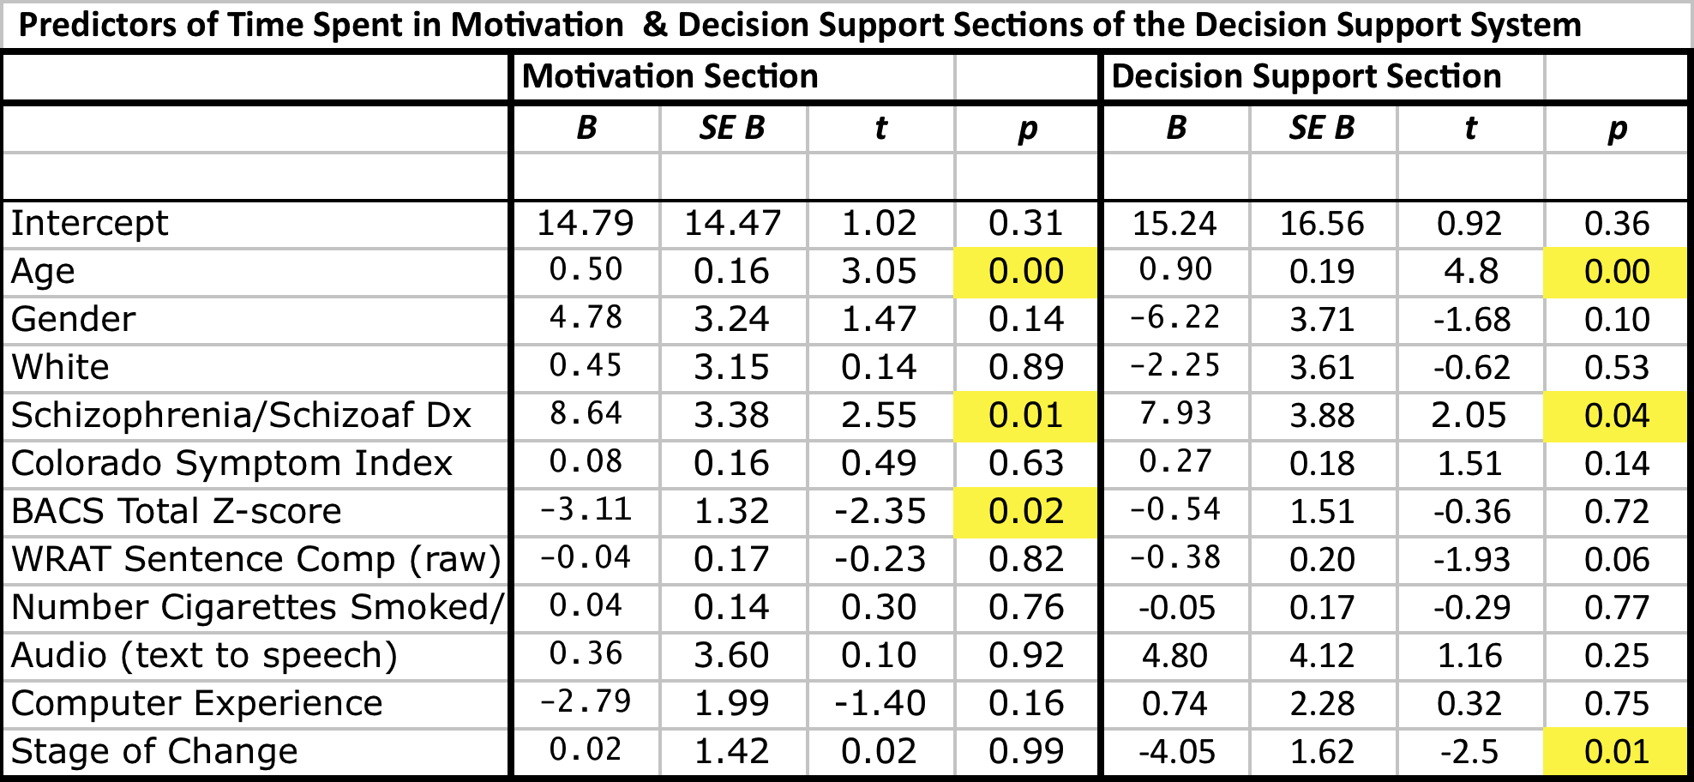
Ferron et al, 2012

Slide 24
6 MONTH FOLLOW-UP DATA
Treatment initiation – 45 (36% initiated treatment)
29% (N=36) attained abstinence (at least 7 days by self report on TLFB)
Predictors of abstinence in real world setting
  Level of education (OR=1.3, CI=1.1-1.6)
  Any use of treatment (quit smoking medications or counseling) predicted abstinence (OR=4.6, CI=2-10.9).
  Diagnosis, cognitive function, symptom level, social support, level of nicotine dependence DID NOT predict abstinence
Relapse was common
  8 (7%) were continuously abstinent, confirmed by CO <6 at 6 mo f/u
(Ferron, Brunette et al, In prep)

Slide 25
Social factors in smoking and cessation
Explicit social influences include observable smoking & quitting behavior of others – quitting may be “contagious (Christakis and Fowler, 2008)
Implicit social influences include attitudes about social norms of smoking, quitting and using cessation reatment, and can sustain smoking (Dohnke 2011) or leverage quitting (Biener 2010)
In SMI, consumers report that peer groups sustain smoking (Davis 2010), social support helps with quitting (Dickerson 2013), but little is known.

Slide 26
Social influences predicting treatment engagement in SMI
 | Medication (R2=.35) | Behavioral (R2=.47)
Demographics | Age (older)
Personal factors | SO Change | SO Change Believe tx effective
Explicit Social Influence |  | # smoked with past week
Implicit Social Influence | Others approve (-); Sig Other would use(+)
Heirarchical logistic regressions examined demographics, personal smoking characteristics, explicit social influences (people smoked with and who quit), implicit social influences (attitudes such as other would approve of or use cessation treatment)
Notes:
Heirarchical logistic regressions examined demographics, personal smoking characteristics, explicit social influences (people smoked with and who quit), implicit social influences (attitudes such as other would approve of or use cessation treatment)
Full model

Slide 27
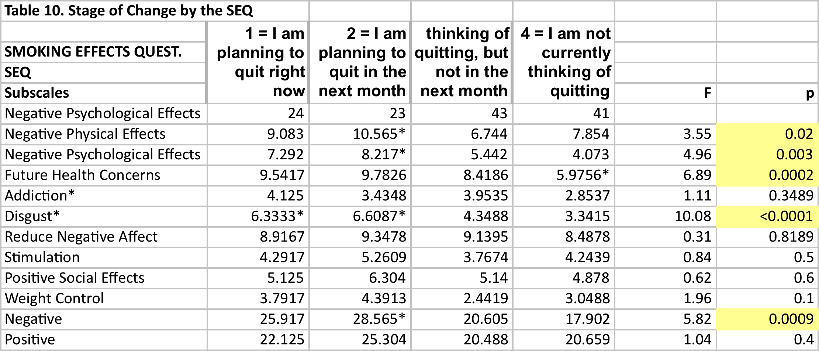
STAGE OF CHANGE AND
SMOKING ATTITUDES

Slide 28
NEXT STEPS REGARDING
TECHNOLOGY IN CESSATION TREATMENTS
Utilize in settings serving disadvantaged populations (Dartmouth SYNERGY Brunette)
Web-based motivational decision support system – RCT underway (NCI Brunette)
Computerized CBT for people with psychotic disorders – Prototype developed (NIDA Brunette)
Cell phone aps (NIDA Ferron et al)
Videoconference training for prescribers (CMS Brunette)

Slide 29

Trial of program in fqhc disadvantaged primary care pts
Concord Hospital Family Health Center, New Hampshire
  Serves thousands of smokers and
  300 pregnant women each year
  30 doctors, family practice
  residency training program
Brunette et al, Under review

Slide 30
CESSATION CBT WEBSITE
Goals:
  Increase convenient access to behavioral treatment
  Provide evidence-based treatment
  Increase acceptability of skills training (for people who don’t like group or don’t want to come to clinic)
  Provide support/skills training in vivo smoking environment
  Provide additional support/skills training to those who do engage in office-based service
  BUILD AND TEST PROTOTYPE

Slide 31
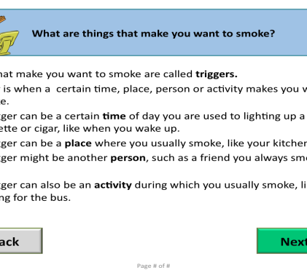
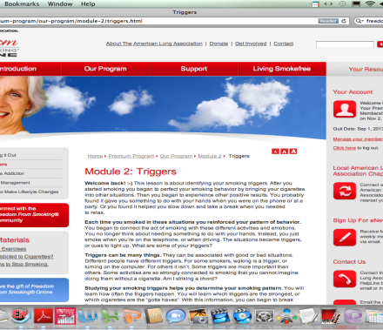
Simple Design and content
- 3 Parts: Interactive CBT, library of information, support group
- Small cash incentive for CBT sessions

Slide 32
PILOT: 4 week in-home use
Logged into the website 7.5 (4-13) times
  Averaged about an hour per log-in session (27-123 mins.)
  Each lesson took about 36 minutes (16-63 mins.)
Looked at 1 library page (0-2)
Used Support Group
  15 page views per participant (0-47)
  Average 2.3 posts per user (0-5)
Usability: All used more than one coaching session (phone or in person); 1 person (20%)with high symptoms and low reading comprehension did not appear to comprehend program.
Outcomes: 1 (20%) quit smoking, an additional 2 (40%) cut smoking in half

Slide 33
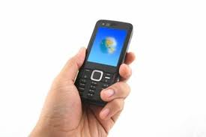
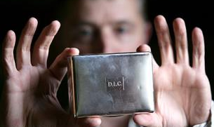
DEVELOPMENT OF THE PACK PAL SYSTEM (Ferron et al)
A mobile application and electronic cigarette pack designed for people with schizophrenia in order to help them track their triggers to smoke and learn more coping skills in their environment

Slide 34
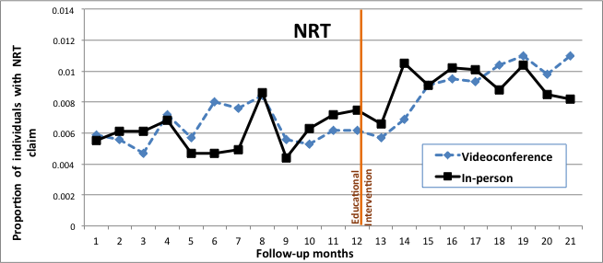
Training prescribers to increase access to biological treatments
Trend after intervention relative to before p=.0075;
Trend after intervention videoconference relative to in person p=.03

Slide 35
Recovery Story/Video

Slide 36
Summary
Web-based behavioral interventions, designed with user testing and feedback, appear promising to help smokers with severe mental illnesses
  CO monitor feedback is not needed in the context of comprehensive interventions with health checklist
Providers require brief training to facilitate access to biological interventions (NRT, bupropion and varenicline)
Ongoing research is needed to further develop and test strategies to facilitate prolonged treatment engagement and cessation in this population

Slide 37
RESEARCH TEAM & COLLABORATORS
Geisel School of Medicine at Dartmouth
    Psychiatric Research Center
    Center of Technology and Behavioral Health
Thresholds, Inc
University of Illinois at Chicago
Feinstein Research Inst.
University of Pittsburgh
Rutgers UMDNJ
Studio4 Technologies

Slide 38


Slide 39

thank you
Notes:
39

